Slide 1

Shape Matching: A Game-Theoretic Perspective
Emanuele Rodolà
rodola@isi.imi.i.u-tokyo.ac.jp

Slide 2

Born + Engineering in Rome

Slide 3

Born + Engineering in Rome

Slide 4

Born + Engineering in Rome

Slide 5

Computer Vision in Venice

Slide 6
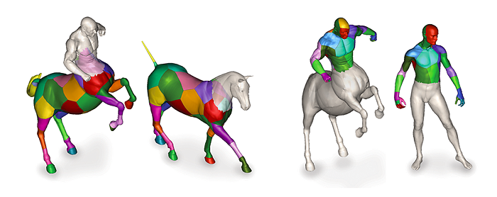
Research in Tel Aviv (Israel)

Slide 7

Research in Tel Aviv (Israel)

Slide 8
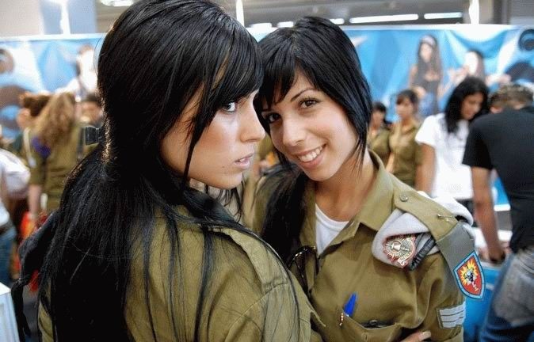
Research in Tel Aviv (Israel)

Slide 9
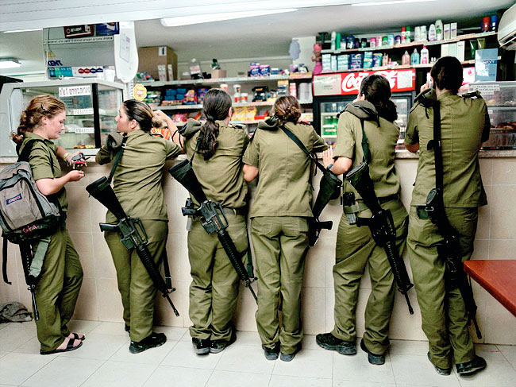
Research in Tel Aviv

Slide 10
Correspondence Problem
We are given a pair of objects

Slide 11
Correspondence Problem
We are given a pair of objects
We assume these objects represent the same entity to some extent

Slide 12
Correspondence Problem
We are given a pair of objects
We assume these objects represent the same entity to some extent
Our task is to find feature-wise correspondences between the objects

Slide 13
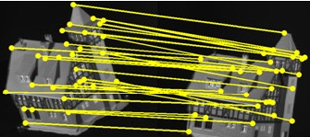
Correspondence Problem
We are given a pair of objects
We assume these objects represent the same entity to some extent
Our task is to find feature-wise correspondences between the objects

Slide 14
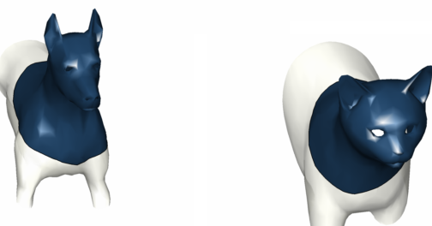
Correspondence Problem
We are given a pair of objects
We assume these objects represent the same entity to some extent
Our task is to find feature-wise correspondences between the objects

Slide 15
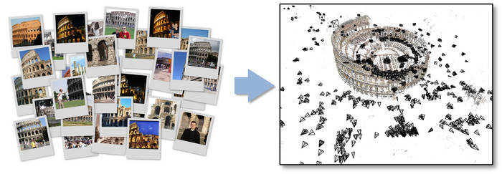
Real-world examples

Slide 16
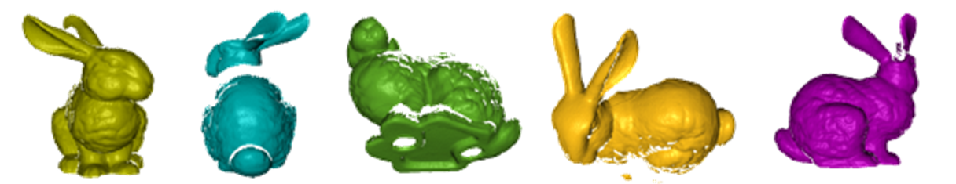
Real-world examples

Slide 17
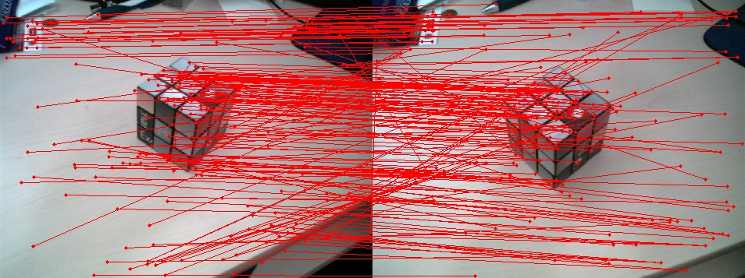
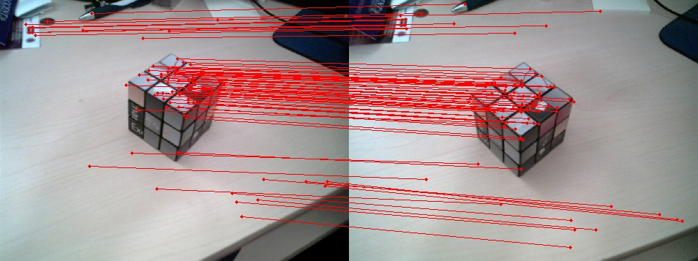
Related Work
Most traditional techniques are feature-based
  Local descriptors (e.g. SIFT) are associated to object points
  Consensus/voting approaches are applied to extract a set of likely hypotheses
RANSAC-Based Darces: A New Approach to Fast Automatic Registration of Partially Overlapping Range Images. C.Chen, Y.Hung, J.Cheng. TPAMI 1999

Slide 18
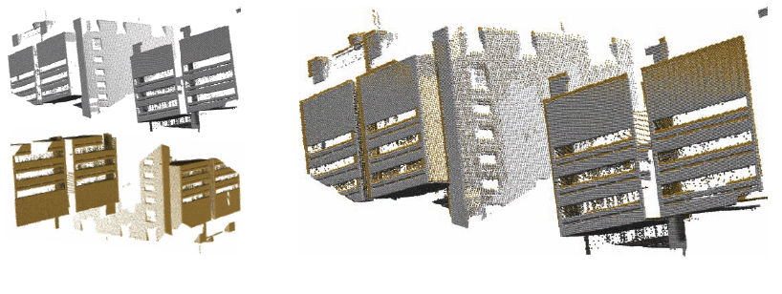
Related Work
Other effective techniques exploit specific information from their applicative domain (e.g. plane matching)
4-Points Congruent Sets for Robust Pairwise Surface Registration. D.Aiger, N.Mitra, D.Cohen-Or. SIGGRAPH 2008

Slide 19
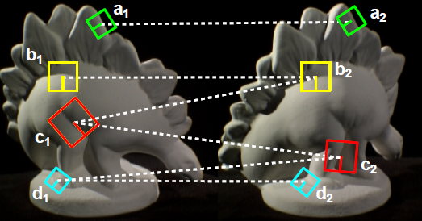
Resorting to Pairwise Constraints

Slide 20
Resorting to Pairwise Constraints

Slide 21
Resorting to Pairwise Constraints

Slide 22
Resorting to Pairwise Constraints

Slide 23
Resorting to Pairwise Constraints

Slide 24
Resorting to Pairwise Constraints

Slide 25
Resorting to Pairwise Constraints
The correspondence problem can be formulated as an assignment problem in which each pair of assignments is given an agreement weight
The solution to the assignment problem is the set of assignments giving the maximum possible agreement

Slide 26
Problem formulation
Given a set of n_{M} model features M and a set of n_{D} data features D, a correspondence mapping C is a set of pairs .
For each pair of assignments there is an associated pairwise affinity measure
Given n candidate assignments, the affinity measures can be materialized in a affinity matrix

Slide 27
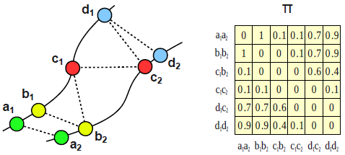
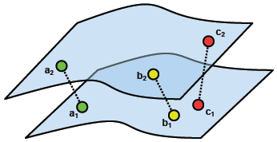
Pairwise affinity
describes how well the relative pairwise geometry (or any type of pairwise relationship) of two model features is preserved after putting them in correspondence with the data features .

Slide 28
Quadratic Assignment Problem
The correspondence problem reduces to finding the cluster C of assignments with maximum score

Slide 29
Quadratic Assignment Problem
We can represent any cluster C by an indicator vector
such that if and zero otherwise.
The inter-cluster score can be rewritten as
The optimal solution x* is the binary vector
The resulting Integer Quadratic Program is NP-Hard

Slide 30
Problem Relaxation
The binary constraint on x can be relaxed to give rise to a fuzzy notion of correspondence, in which
x*(a) may be interpreted as a measure of association of a with the best cluster C*
Since only the relative values between the elements of x matter, we can impose
We arrive at the quadratic problem

Slide 31
A spectral solution
By Rayleigh’s quotient theorem, x* maximizing the score is the principal eigenvector of
Finally, since , by Perron-Frobenius theorem the elements of x* will have the same sign and be in

Slide 32
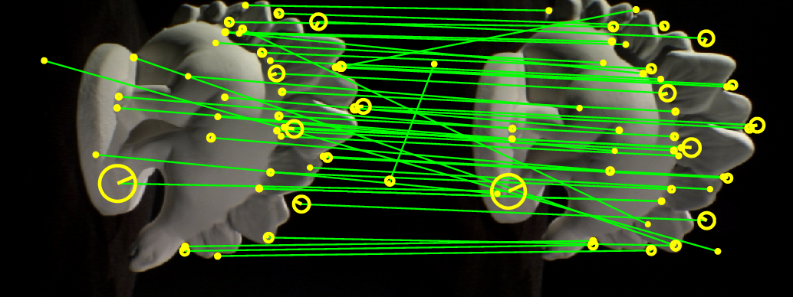
A spectral solution (cont’d)
The spectral approach turns out to be inefficient and to have stability issues in the presence of outliers
A Spectral Technique for Correspondence Problems Using Pairwise Constraints. M.Leordeanu, M.Hebert. ICCV 2005

Slide 33
An inlier selection approach
We cast the matching problem to an inlier selection problem in which we are interested in few, stable inliers even under strong outlier noise.

Slide 34

Attaining sparsity
Following a sparsity ansatz found in signal processing, we propose to further relax the constraints on x, arriving at:
Thus, we are seeking to optimize over the standard n-simplex

Slide 35
Game Theory in Computer Vision
Originated in the early 40’s, Game Theory was an attempt to formalize a system characterized by the actions of entities with competing objectives, which is thus hard to characterize with a single objective function.
According to this view, the emphasis shifts from the search of a local optimum to the definition of equilibria between opposing forces.

Slide 36
Game Theory (cont’d)
Multiple players have at their disposal a set of strategies and their goal is to maximize a payoff (or reward) that depends on the strategies adopted by other players.

Slide 37
Preliminaries
Let enumerate the set of available pure strategies, our candidate matches
Let specify the payoffs among i- and j-strategists
A mixed strategy is a probability distribution over the set of strategies
The support of a mixed strategy x, denoted by σ(x), is defined as the set of elements chosen with non-zero probability: .

Slide 38
Expected payoff
The expected payoff received by a player choosing element i when playing against a player adopting a mixed strategy x is .
The expected payoff received by adopting the mixed strategy y against x is .

Slide 39
Nash Equilibria
The best replies against mixed strategy x:
A central notion is that of a Nash Equilibrium. A strategy x is said to be a NE if it is a best reply to itself, i.e. , implying:

Slide 40
Evolutionary Dynamics
We undertake an evolutionary approach to the computation of Nash equilibria.
We consider a scenario where pairs of individuals are repeatedly drawn at random from a large population to perform a two-player game.
A selection process operates over time on the distribution of behaviors, favoring players that receive higher payoffs.

Slide 41
Evolutionary Stable Strategies
In this dynamic setting, the concept of stability, or resistance to invasion by new strategies, becomes central.
A strategy x is said to be an evolutionary stable strategy (ESS) if it is a NE and
This condition guarantees that any deviation from the stable strategies does not pay.

Slide 42
A link with Optimization Theory
Stable states correspond to the strict local maximizers of the average payoff over the simplex, whereas all critical points are related to Nash Equilibria

Slide 43
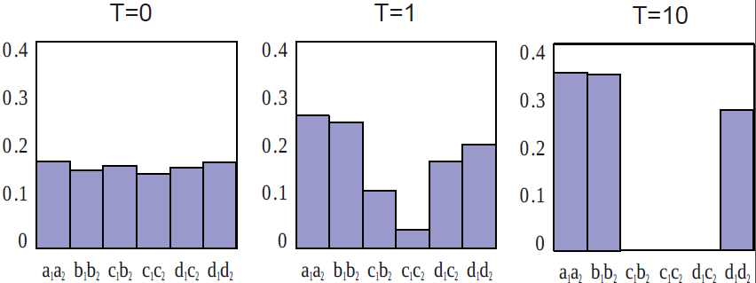
The selection process
The search for a stable state is performed by simulating the evolution of a natural selection process.
Many algorithms with different mathematical properties have been proposed in literature.

Slide 44
Replicator Dynamics
Under this dynamics, the average payoff of the population is also guaranteed to strictly increase (provided the matrix is nonnegative and symmetric), and x(t+1) = x(t) only when x is a stationary point for the dynamics.

Slide 45
Replicator Dynamics
The fraction of individuals adopting strategy i will grow over time whenever their expected payoff exceeds the population average, decreasing otherwise.
Any such sequence will always converge to a unique solution (a Nash Equilibrium).
Very simple implementation and rather efficient
Biologically motivated

Slide 46
The Matching Game
Define the set of strategies available to the players
Define the payoffs related to these strategies (payoff matrix) by means of some payoff function
Initialize the population vector (e.g., at the barycenter of the simplex)
Run the evolutionary process until an equilibrium is reached

Slide 47
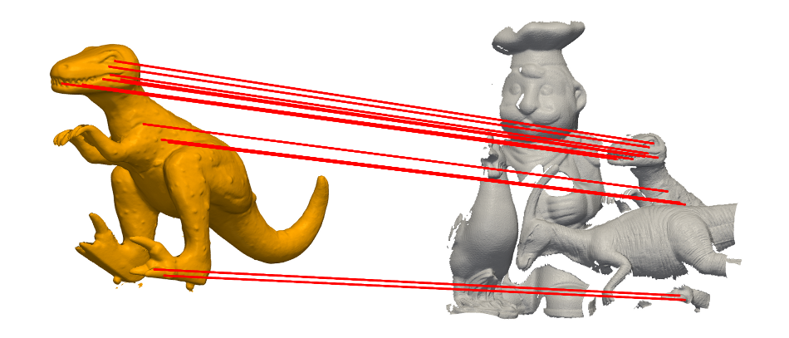
Object-in-clutter recognition
The inlier selection behavior finds a direct application in object-in-clutter recognition
A Scale-Independent Selection Process for 3D Object Recognition in Cluttered Scenes. E.Rodolà, A.Albarelli, F.Bergamasco, A.Torsello. 3DIMPVT 2011, IJCV 2012 (to appear).

Slide 48
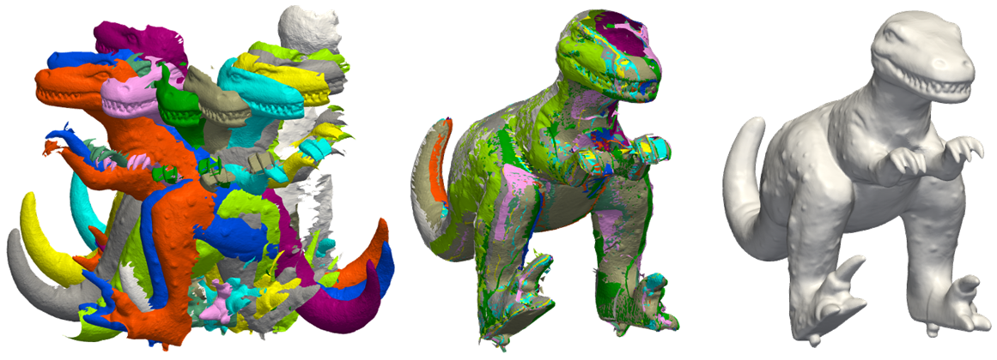
Rigid surface alignment
Fast and Accurate Surface Alignment Through an Isometry-Enforcing Game. A.Albarelli, E.Rodolà, A.Torsello. CVPR 2010, TPAMI 2012 (to appear).

Slide 49
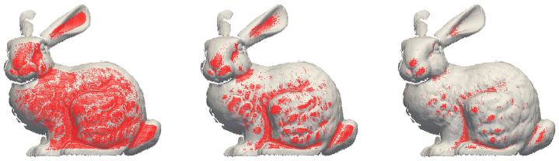
Feature detection
Adopting single local features as game strategies gives rise to an effective clustering approach
Loosely Distinctive Features for Robust Surface Alignment. A.Albarelli, E.Rodolà, A.Torsello. ECCV 2010.

Slide 50
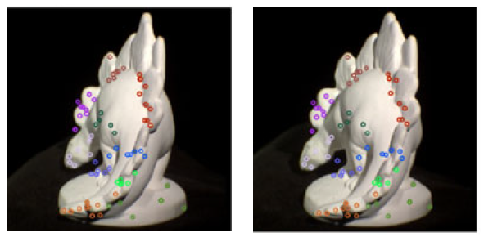
Feature matching for SfM
We can enforce an affine or epipolar (instead of isometric) constraint to match SIFT-like features
Imposing Semi-local Geometric Constraints for Accurate Correspondences Selection in SfM. A.Albarelli, E.Rodolà, A.Torsello. 3DPVT 2010, IJCV 2012.

Slide 51
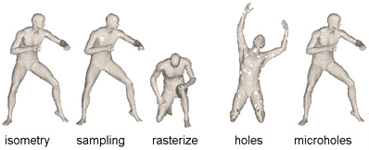
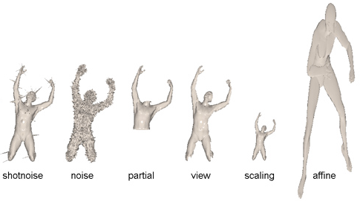
Matching non-rigid shapes

Slide 52
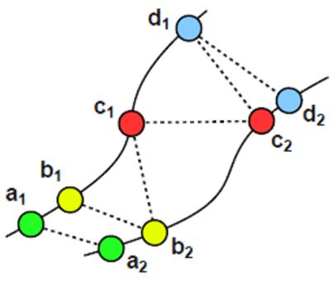
Matching non-rigid shapes
Resilience to different kinds of deformation depends on the specific choice of a metric d*() on the shapes.
Just like in the rigid case, we are going to enforce isometries of the shapes according to some payoff/affinity function π.

Slide 53
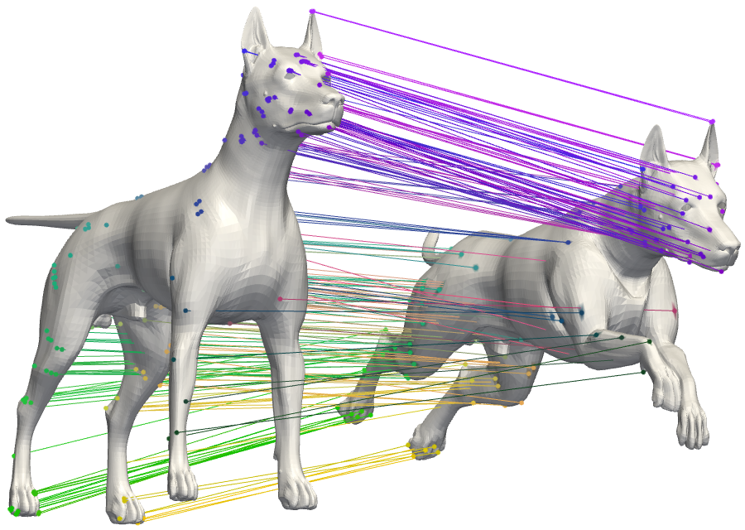
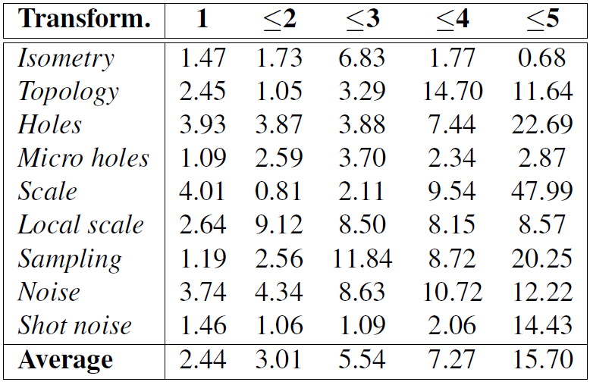
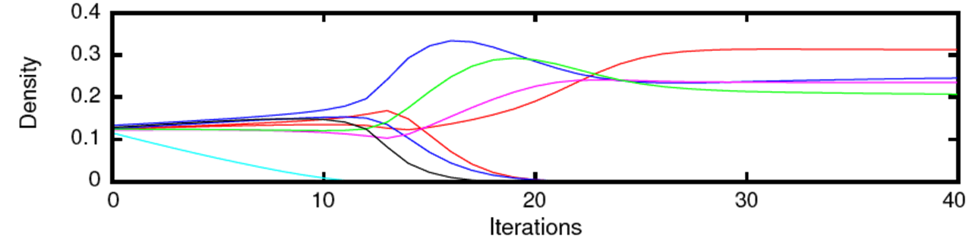
Experimental results

Slide 54
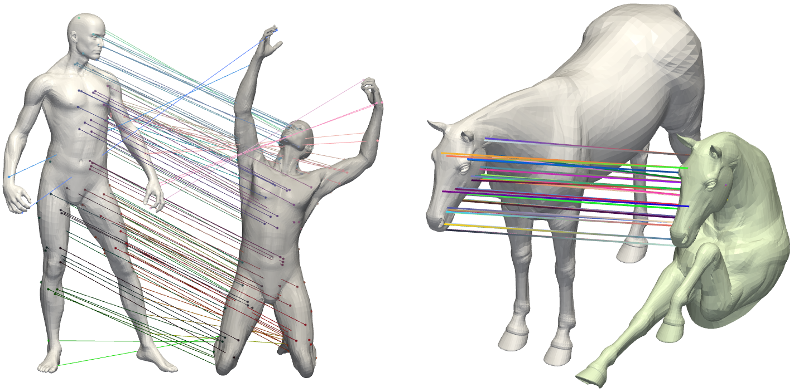
Qualitative results
A Game-Theoretic Approach to Deformable Shape Matching. E.Rodolà, A.Bronstein, A.Torsello. CVPR 2012.

Slide 55
Conclusions
We approached the all-pervasive correspondence problem in Computer Vision.
Our main results took advantage of recent developments in the emerging field of game-theoretic methods for Machine Learning and Pattern Recognition.
We shaped a general framework that is flexible enough to accommodate rather specific and commonly encountered correspondence problems within the areas of 3D reconstruction and shape analysis.
We were able to apply said framework to a non-rigid 3D matching scenario and tested its effectiveness.

Slide 56
Future directions
Perform a probabilistic analysis of the framework and its selection process
Introduce a space-regularization term over the set of correspondences
Investigate the links with optimization theory
A fast GPU implementation would allow us to consider higher-order matching problems (anybody interested?)

Slide 57
Thank you!
Questions?

